Slide 1
UNIVERSITY MANAGEMENT SYSTEM Application
Presented By:
ZOYA NAVEED (2021-CS-201)

Slide 2
ABOUT
Welcome to our advanced University Management System, designed to streamline your academic journey. Your personalized profile page provides a comprehensive view of academic progress, including courses enrolled, grades, and notifications. Seamless registration and course addition features empower you to tailor your academic experience. Stay informed with instant notifications on important events, deadlines, and announcements. Easily upload assignments and access a centralized hub for submission and feedback. Effortlessly manage fees with a secure payment system and gain insights into your financial standing. Finally, track your academic achievements in real-time with the results dashboard page, ensuring you're always up-to-date on your academic performance. This user-centric platform aims to enhance your university experience by integrating essential functionalities for a more efficient and connected educational journey.

Slide 3
Project Features
Authentication
Authorization
Courses
Notifications
Assignments
Result
Fees

Slide 4
Technology used
Language
DART
Framework
FLUTTER
IDE
Visual Studio CODE
NODEJS
ANDROID STUDIO

Slide 5
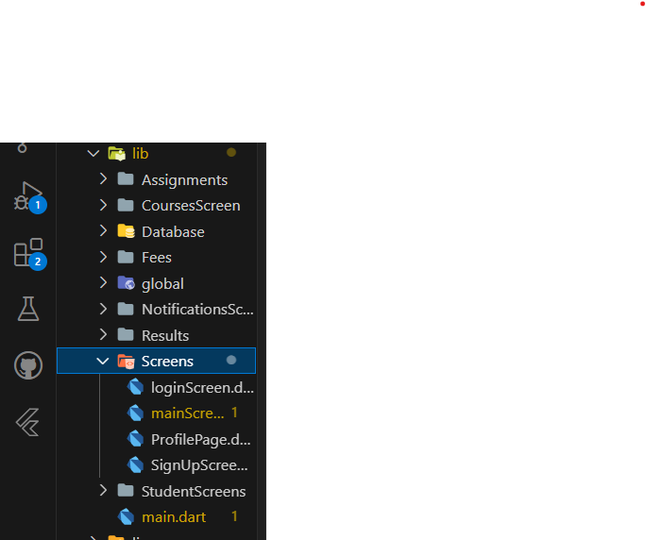
Project Structure
  The structure of the project

Slide 6
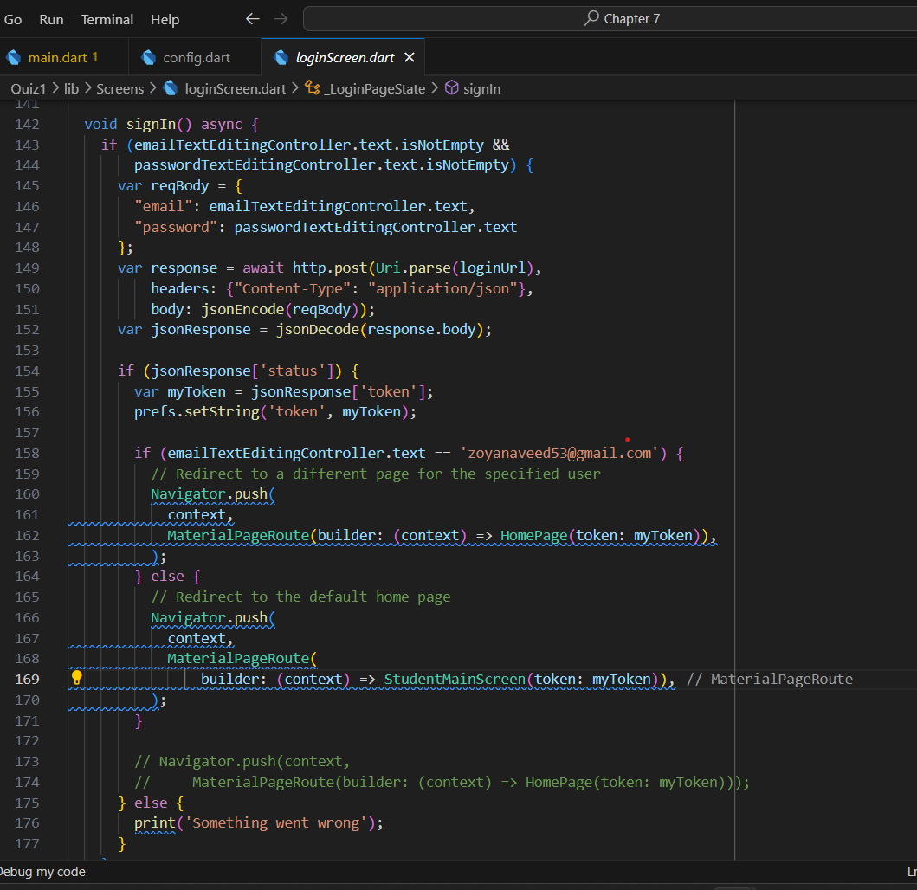
Comments and Formatting
  The commenting and formatting of the project as well as the naming convention is shown:

Slide 7
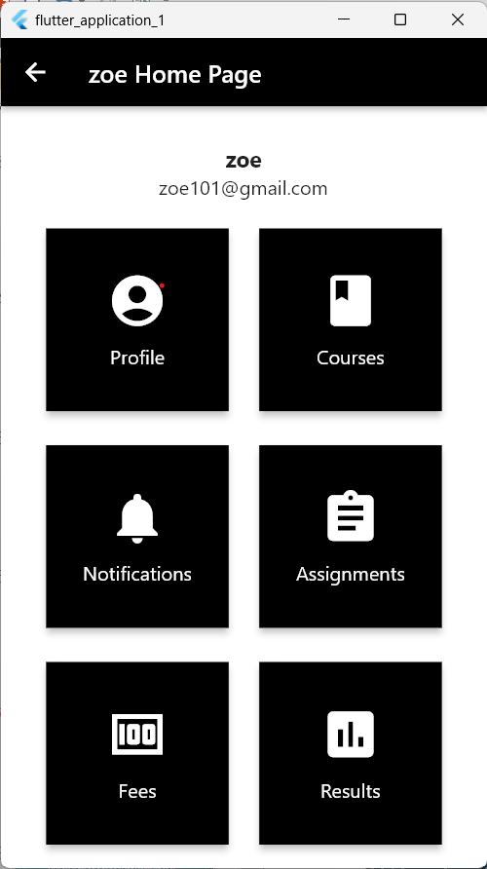
Theme
  The Homepage of the App:

Slide 8

Project management tool

Slide 9
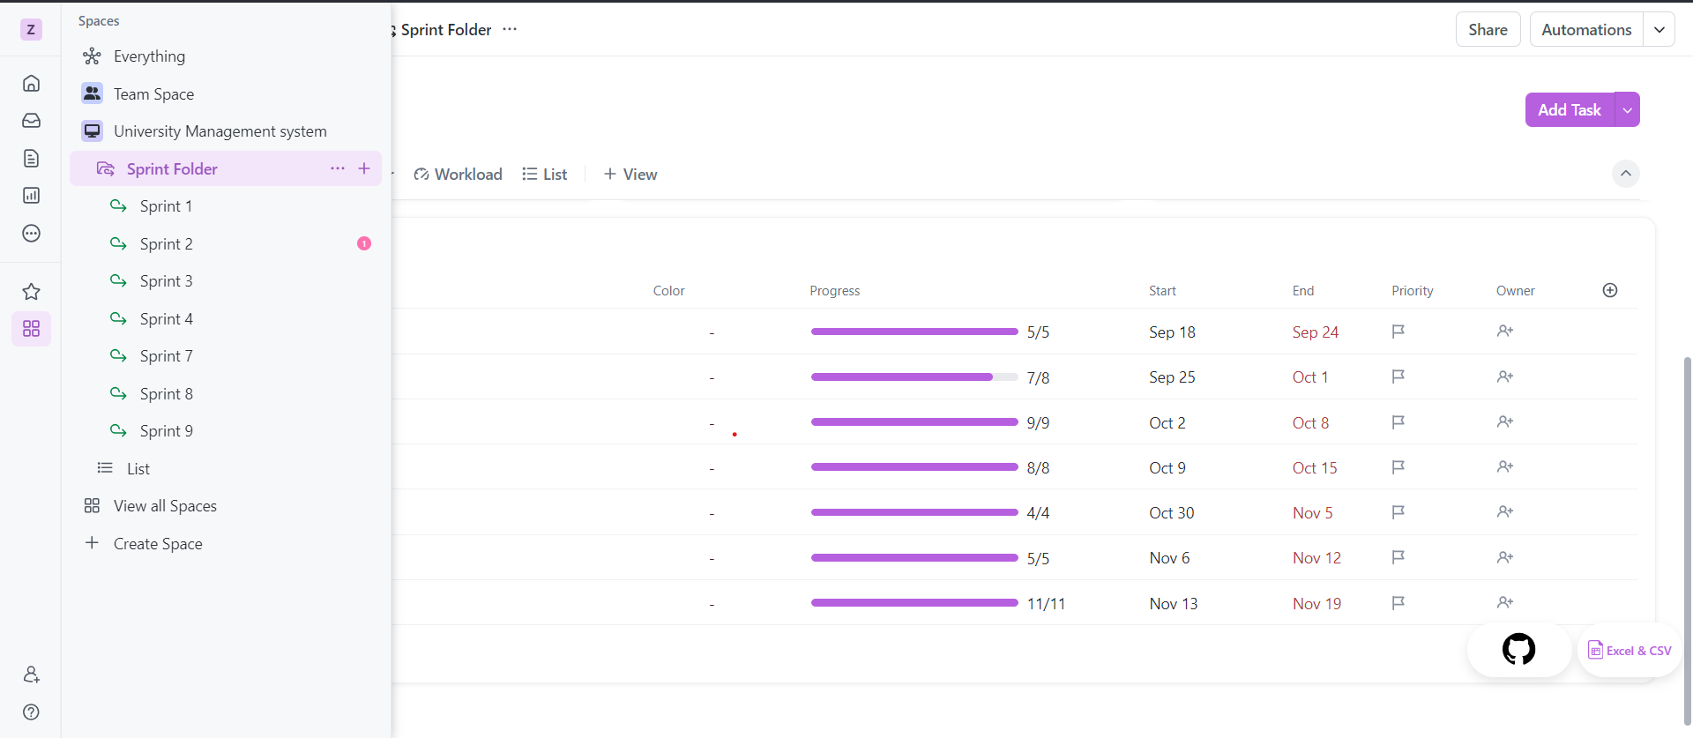
Project management tool

Slide 10

Tool used for communication with client

Slide 11
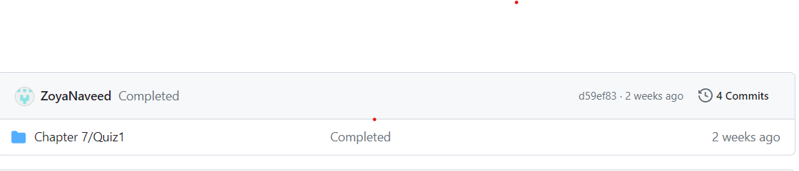
GITHUB
  Total commits: 4
  Reason: Repository
  issues

Slide 12
THANK YOU!

